Slide 1
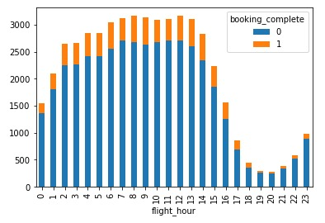
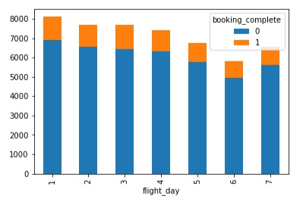
Using a machine learning model k-nearest neighbors classifier, we tested all possible combinations of numerical columns to find the best attributes for predicting customer bookings. All columns performed within 1% accuracy of each other, or 85% accuracy for predicting bookings. With that information, we decided to perform our cross-validation testing phase on flight hour and flight day data, finding that these attributes also performed at an accuracy of 85%.
Visualizing these attributes in relation to completed bookings, we can see that customers that booked overnight flights are far more likely to complete their bookings.

